Slide 1
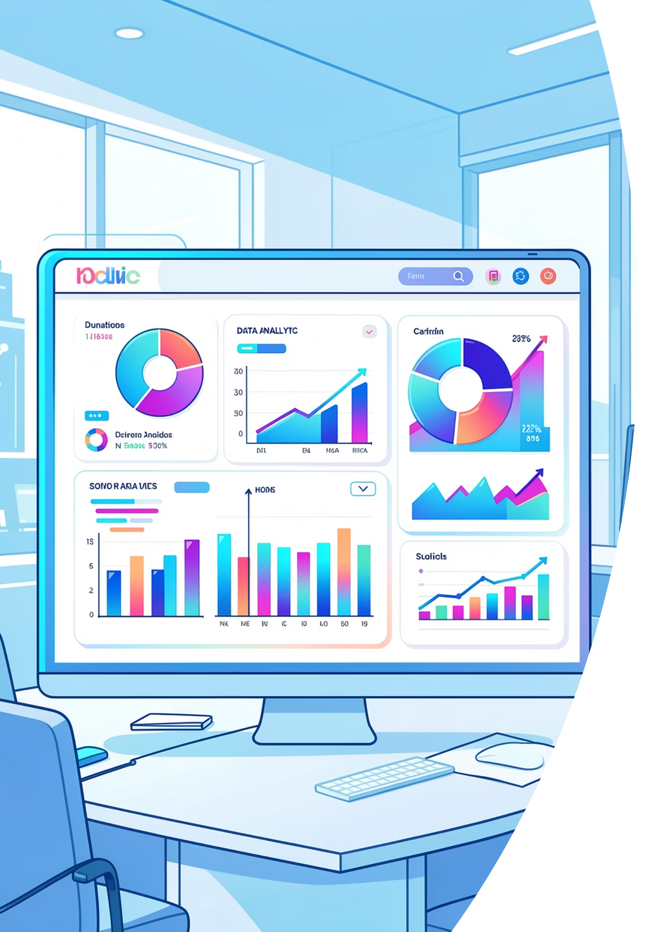
Customer Shopping Behavior Analysis
Analyzing 3,900 purchases to uncover spending patterns, customer segments, and strategic insights for business growth.

Slide 2
DATASET OVERVIEW
Understanding Our Data
3,900
18
$59.76
3.75
Total Purchases
Data Points
Avg Purchase
Avg Rating
Transactions analyzed across all categories
Features tracked per customer
Mean transaction value
Customer satisfaction score
Dataset includes customer demographics, purchase details, shopping behavior, and subscription status across 50 locations.

Slide 3
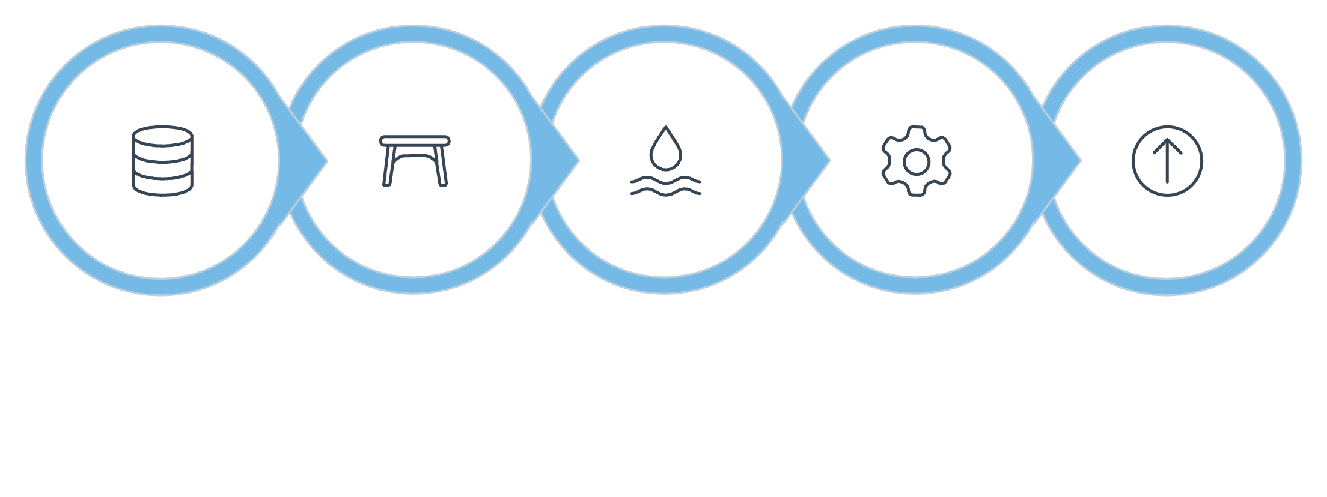

PYTHON ANALYSIS
Data Preparation & Cleaning
Missing Data
Imputed 37 missing review ratings using category medians
Feature Engineering
Created age groups and purchase frequency metrics
Load Data
Explore Structure
Handle Missing
Engineer Features
Export to DB
Standardization
Systematic approach to ensure data quality and consistency for analysis.
Renamed columns to snake_case for consistency

Slide 4
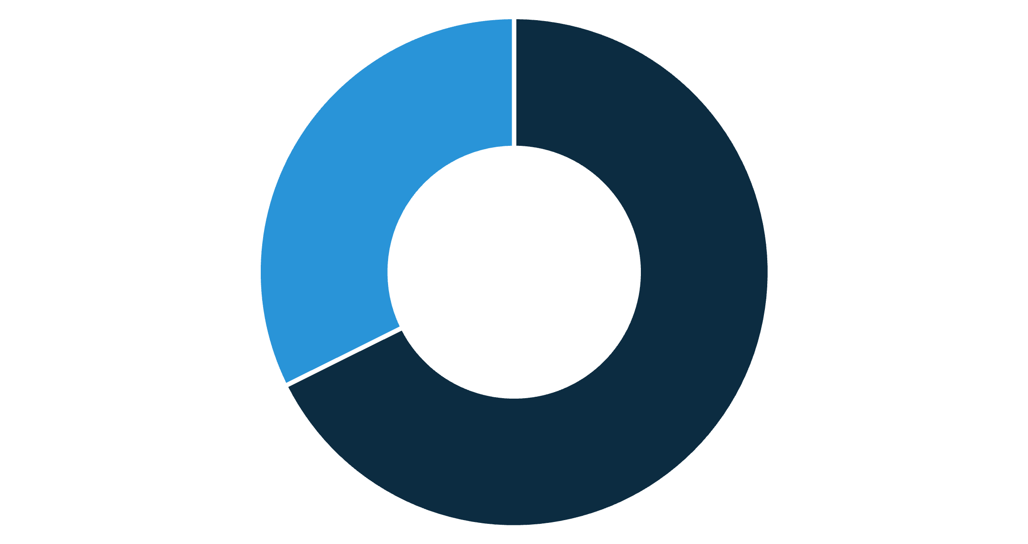
SQL INSIGHTS
Revenue Analysis by Gender
Male customers generate 68% of total revenue ($157,890) compared to female customers at 32% ($75,191).
This significant disparity suggests opportunities for targeted marketing campaigns to increase female customer engagement and spending.
Male
Female

Slide 5
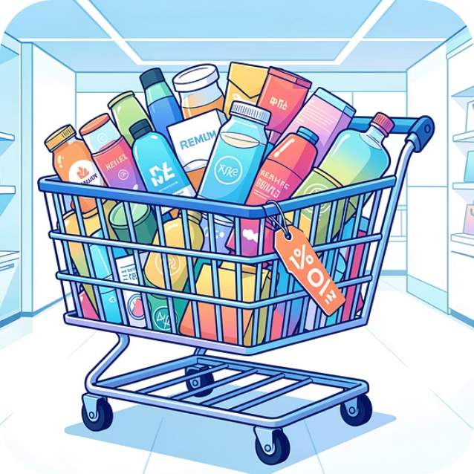
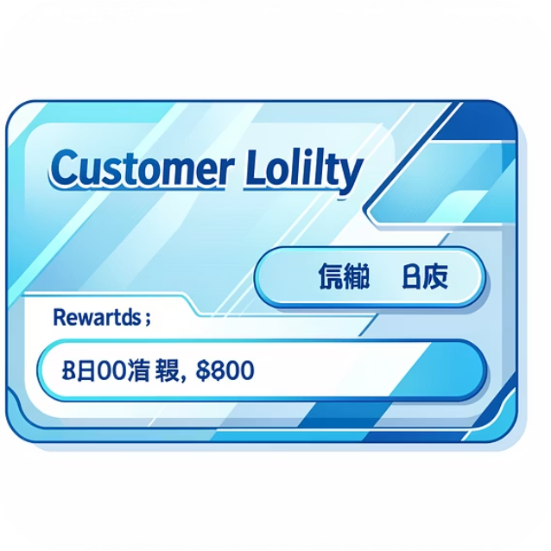
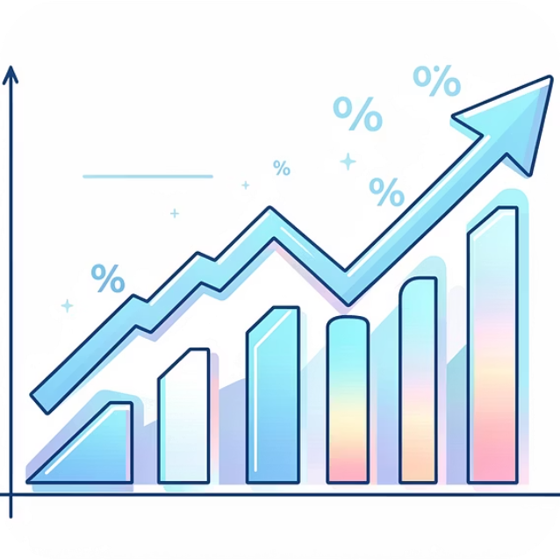
Smart Discount Users
839 customers used discounts while still spending above the $59.76 average—demonstrating that promotions can drive higher-value purchases without sacrificing revenue.
High-Value Discounting
Customer Retention
Revenue Protection
Strategic promotions attract quality buyers, not just bargain hunters
Discounts build loyalty among high-spending segments
Above-average purchases offset discount impact on margins

Slide 6


PRODUCT PERFORMANCE
Top-Rated Products & Shipping Insights
Highest-Rated Items
77%
77%
76%
Gloves
Sandals
Boots
3.86 average rating
3.84 average rating
3.82 average rating
Shipping Impact
Express shipping customers spend $2 more per order ($60.48 vs $58.46 standard).
Premium shipping correlates with higher purchase values—consider promoting express options to boost revenue.

Slide 7
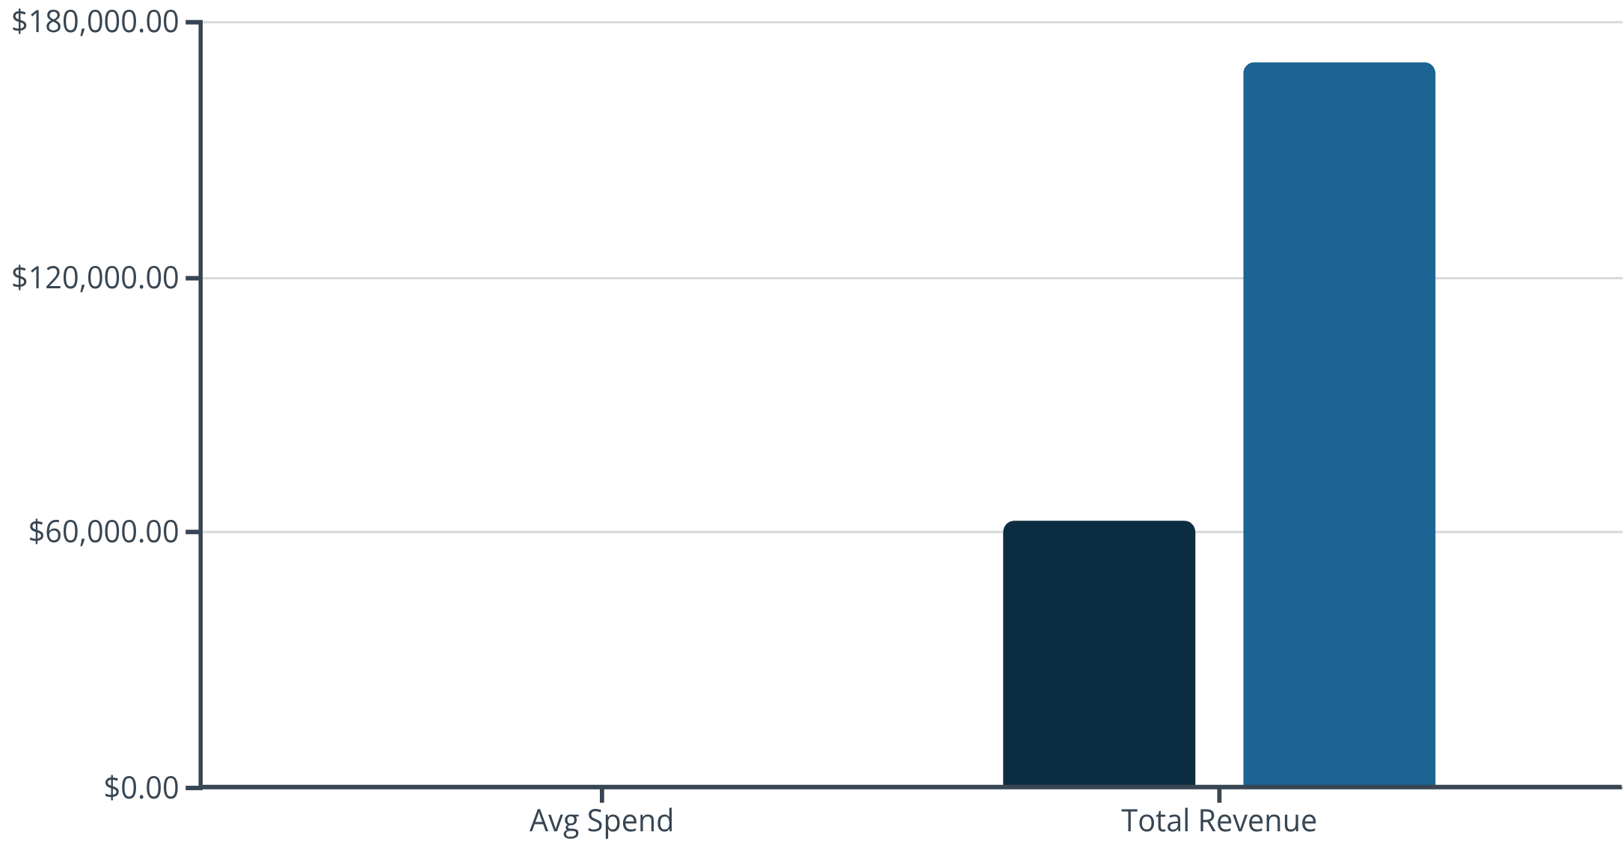
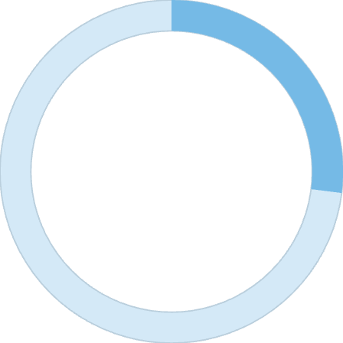
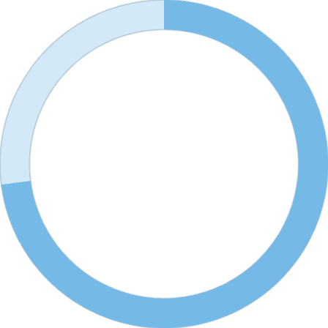
Subscription Status Analysis
Subscribers
Non-Subscribers
27%
73%
Subscribers
Non-Subscribers
1,053 customers
2,847 customers
Massive opportunity: 73% of customers aren't subscribed despite similar spending patterns.

Slide 8

SEGMENTATION
Customer Loyalty Breakdown
Loyal Customers
Returning Buyers
3,116 customers (80%)
701 customers (18%)
Core revenue drivers with established purchase patterns
Growing segment showing repeat purchase behavior
New Customers
83 customers (2%)
Fresh acquisition opportunities for growth
958 repeat buyers (>5 purchases) remain unsubscribed—prime targets for subscription conversion campaigns.

Slide 9
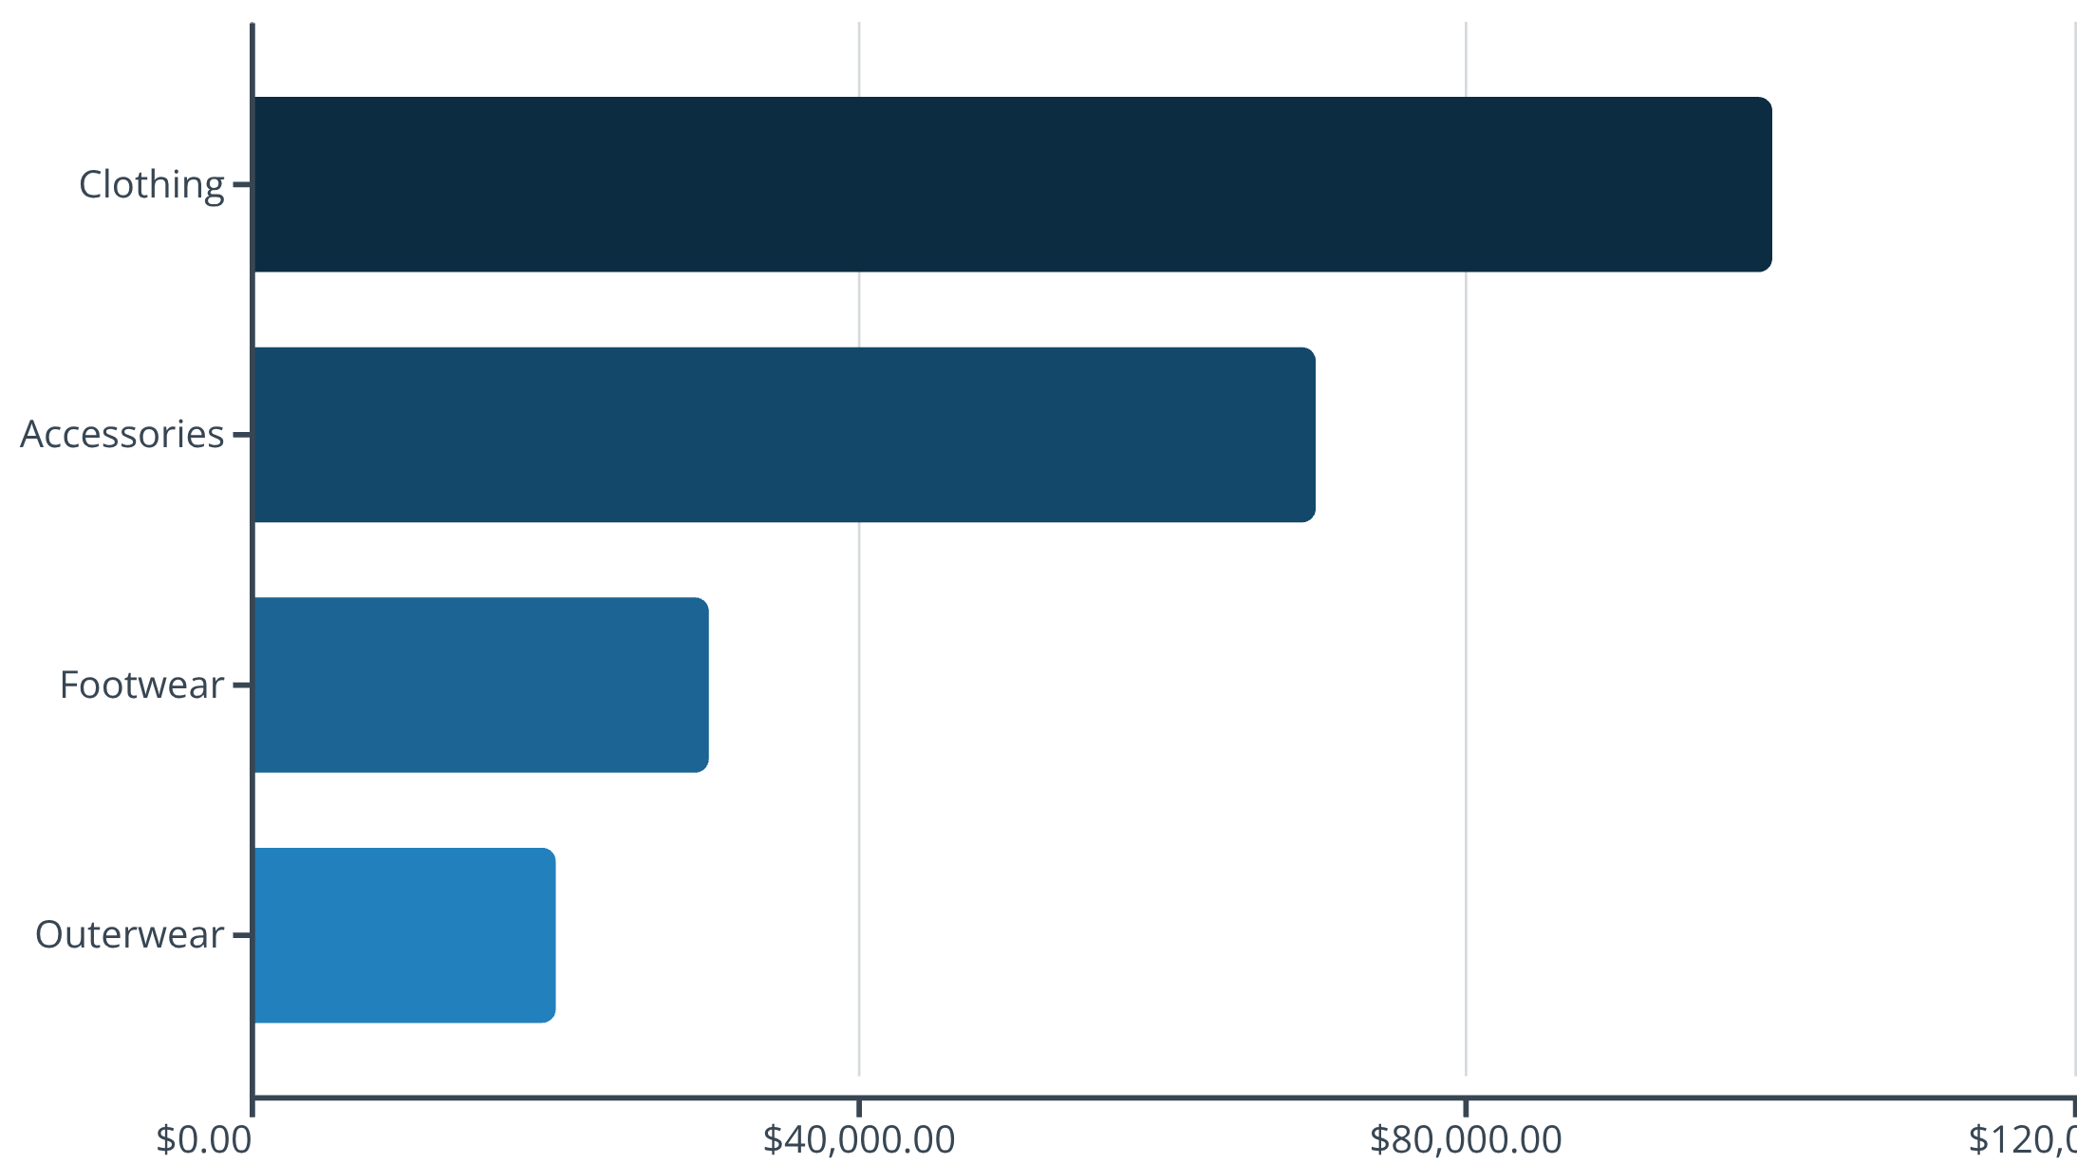
CATEGORY PERFORMANCE
Revenue & Sales by Category
Top Products by Category
Accessories: Jewelry (171 orders)
Clothing: Blouse & Pants (171 orders each)
Footwear: Sandals (160 orders)
Outerwear: Jacket (163 orders)
Clothing dominates at 43% of revenue. Young adults lead spending at $62,143 total.

Slide 10




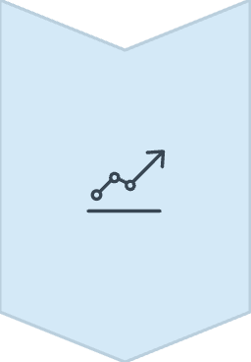
ACTION PLAN
Strategic Recommendations
Boost Subscriptions
Convert 958 repeat buyers with exclusive benefits—potential $57K additional revenue
Loyalty Programs
Reward returning buyers to accelerate movement into loyal segment
Optimize Discounts
Focus promotions on high-value items—839 customers prove discounts work for premium buyers
Targeted Marketing
Emphasize top-rated products and express shipping to young adult segment

